Slide 1
Java 4 WEB
Lesson 14 – Java Database Connectivity

Slide 2
Lesson goals
Connect to Database (DB)
Change database structure
Execute read/write queries
Modify database content

Slide 3
Java Database Connectivity (JDBC)
Data is information
Database - organized collection of data
Database types:
Relational - organized into tables, which consist of rows and columns. A relational database is accessed through Structured Query Language (SQL).
Non-relational - NoSQL database, non-structured.
Notes:
NoSQL - databases that store their data in a format other than tables.

Slide 4
Java Database Connectivity (JDBC)
Platform-independent industry standard for the interaction of Java-applications with various DBMS, implemented in java.sql package.
The latest version for Java 11 is JDBC 4.3 (since Java 9)
Java Application
Database
JDBC
Driver

Slide 5
Terminology
DDL - data definition language
DML - data manipulation language
SQL keywords are case insensitive in most dialects
Common practice to use underscores to separate "words” in column and table names

Slide 6
Ways to access relational database from Java
JDBC - accesses data as rows and columns.
JPA (Java Persistence API) - accesses data through Java objects using a concept called object-relational mapping (ORM)

Slide 7
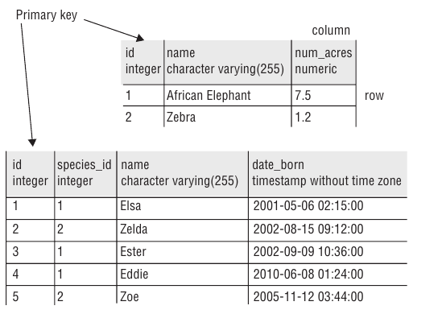
Structure of a Relational Database
Primary key column - gives a unique way to reference each row.

Slide 8
Basic SQL Statements
INSERT (Create) - Add a new row to the table
SELECT (Read) - Retrieve data from the table
UPDATE (Update) - Change zero or more rows in the table
DELETE (Delete) - Remove zero or more rows from the table

Slide 9
CRUD
try (Connection connection = DriverManager.getConnection( "jdbc:postgresql://localhost:5432/firstname_lastname", "username", "password" ); Statement statement = connection.createStatement(); ) {
ResultSet get = statement.executeQuery("SELECT name FROM animal"); int ins = statement.executeUpdate("INSERT INTO animal VALUES(1, 2, 'Deer', '12-12-2017')"); int upd = statement.executeUpdate("UPDATE animal SET name=‘Big Deer‘ WHERE name = ‘Deer’"); int del = statement.executeUpdate("DELETE FROM animal WHERE id = 1"); } catch (SQLException e) { // process exception... }

Slide 10
Driver
Driver - JAR file with classes that know how to talk to a specific database
The interfaces are declared in the JDK
Implementation comes within JDBC driver. Each database has a different JAR file with these classes: ‘org.postgresql:postgresql:42.2.5‘, ‘mysql:mysql-connector-java:8.0.14’, …

Slide 11
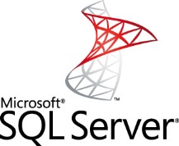
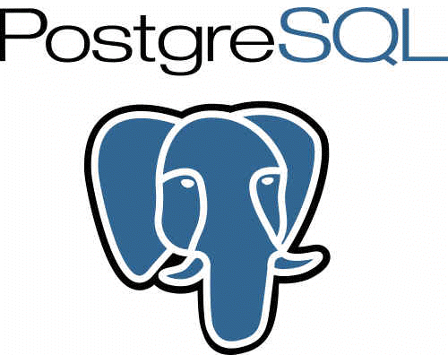



Driver
MySQL
Microsoft
SQL
Server
Postgre
SQL
Oracle
SQLite
MySQL
JDBC
Driver
MS SQL
JDBC
Driver
PostgreSQL
JDBC
Driver
Oracle
JDBC
Driver
SQLite
JDBC
Driver
JDBC Interface
Java Application

Slide 12
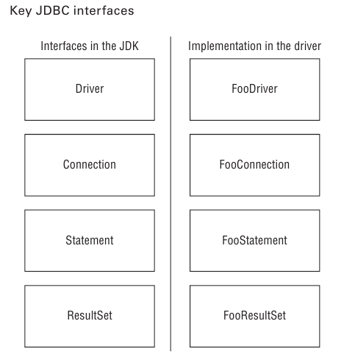
Key JDBC interfaces

Slide 13
Key JDBC interfaces
Driver - Knows how to get a connection to the database
Connection - Knows how to communicate with the database
Statement - Knows how to run the SQL
ResultSet - Knows what was returned by a SELECT query and how to work with that

Slide 14
Connecting to Database - Register driver
Add driver jar to classpath. Jar contains a meta-file ‘java.sql.Driver’ (mandatory since java 6) inside with one line - the fully qualified package name of the Driver implementation class. DriverManager then looks through any drivers it can find to see if they can handle the JDBC URL. If so, it creates a Connection using that Driver. If not, it gives up and throws a SQLException.

Slide 15
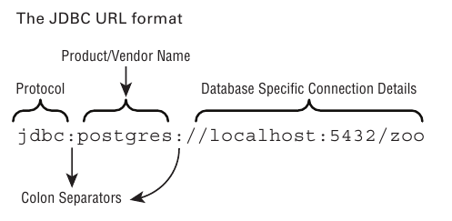
Connecting to Database - Build the JDBC URL

Slide 16
Connecting to Database - Get a Connection
DriverManager (factory, getConnection())
DataSource (factory, has more features than DriverManager like connections pool or external configuration)

Slide 17
Get a Connection
try (Connection connection = DriverManager.getConnection( "jdbc:postgresql://localhost:5432/db", "username", "password" ); ) {
// do something…
} catch (SQLException e) { // process exception... }

Slide 18
Obtain a Statement
try (Connection connection = DriverManager.getConnection( "jdbc:postgresql://localhost:5432/db", "username", "password" ); Statement statement = connection.createStatement(); ) {
// do something…
} catch (SQLException e) { // process exception... }

Slide 19
Statements
Statement | PreparedStatement | CallableStatement
Generic interface for data access and modification Batch operations execution Provides access to result set Sent to the database server each and every time. | can be used several times with different parameters can be performed more quickly, due to the preliminary construction of the execution plan (depends on the database) cached | interface for running stored procedures and functions access to specific parameters returned by stored procedures

Slide 20
Java SQL Class Diagram
Statement
ResultSet
createStatement
provides
DriverManager
Connection
prepareStatement
PreparedStatement
ResultSetMetaData
Driver
prepareCall
SQLException
provides
CallableStatement
DatabaseMetaData
SQLWarning
DriverPropertyInfo
DataTruncation

Slide 21
Prepared Statement
Better Performance - figures out a plan to run the SQL well and remembers it
Security - uses placeholders for input parameters, instead of concatenation. I.E. prevents SQL injections
Readability - no need to deal with string concatenation in building a query string with lots of variables

Slide 22
Prepared Statement
try (Connection connection = DriverManager.getConnection( "jdbc:postgresql://localhost:5432/db", "username", "password" ); ) { String animalToFree = "Zebrony";
Statement stmt = connection.createStatement(); String sql = "DELETE FROM animal WHERE name = '" + animalToFree + "'"; System.out.println(sql); stmt.executeUpdate(sql); PreparedStatement ps = connection.prepareStatement("delete from animal where name = ?"); ps.setString(1, animalToFree); ps.execute(); } catch (SQLException e) { /* process exception... */ }

Slide 23
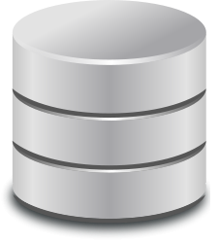

Callable Statement
CallableStatement cs = connection.prepareCall("{call userStatistics(?, ?)}");
cs.setString(1, "12/20/2012");
cs.setInt(2, 1000);
cs.registerOutParameter(1, java.sql.Types.VARCHAR);
cs.registerOutParameter(2, java.sql.Types.INTEGER);
ResultSet result = cs.executeQuery();
while(result.next()) {...}
String out1 = cs.getString(1);
int out2 = cs.getInt(2);

Slide 24
ResultSet navigation
Method | Description | Requires Scrollable ResultSet
boolean absolute(int rowNum) | Move cursor to the specified row number | Yes
void afterLast() | Move cursor to a location immediately after the last row | Yes
void beforeFirst() | Move cursor to a location immediately before the first row | Yes
boolean first() | Move cursor to the first row | Yes
boolean last() | Move cursor to the last row | Yes
boolean next() | Move cursor one row forward | No
boolean previous() | Move cursor one row backward | Yes
boolean relative(int rowNum) | Move cursor forward or backward the specified number of rows | Yes

Slide 25
Getting Data from a ResultSet
Сall rs.next() to read data
Always use an if statement or while loop when calling rs.next()
Column indexes begin with 1
Prefer access data by column name

Slide 26
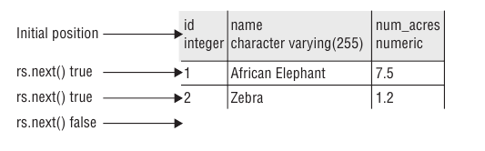
Getting Data from a ResultSet

Slide 27
Getting Data from a ResultSet
Method Name | Return Type | Example Database Type
getBoolean | boolean | BOOLEAN
getDate | java.sql.Date | DATE
getDouble | double | DOUBLE
getInt | int | INTEGER
getLong | long | BIGINT
getObject | Object | Any type
getString | String | CHAR, VARCHAR
getTime | java.sql.Time | TIME
getTimeStamp | java.sql.TimeStamp | TIMESTAMP
Notes:
Keep attention that return type are primitives. When null is stored in database, then default value will be returned for type during result set processing

Slide 28
Getting Data from a ResultSet
try (Connection connection = DriverManager.getConnection( "jdbc:postgresql://localhost:5432/db", "username", "password" ); Statement stmt = connection.createStatement(); ) { Map<Integer, String> idToNameMap = new HashMap<>(); ResultSet rs = stmt.executeQuery("SELECT id, name FROM species"); while (rs.next()) { int id = rs.getInt(1); // by column index (index from 1) not recommended String name = rs.getString("name"); // by column name. PREFERRED!!! idToNameMap.put(id, name); } System.out.println(idToNameMap); // {1=African Elephant, 2=Zebra} } catch (SQLException e) { /* process exception... */ }

Slide 29
Executing an unknown Statement
try (Connection connection = DriverManager.getConnection( "jdbc:postgresql://localhost:5432/db", "username", "password" ); Statement statement = connection.createStatement(); ) {
boolean isResultSet = statement.execute("..."); if (isResultSet) { ResultSet rs = statement.getResultSet(); System.out.println("run a query"); } else { int result = statement.getUpdateCount(); System.out.println("run an update"); } } catch (SQLException e) { /* process exception... */ }

Slide 30
What is wrong?
try (Connection connection = DriverManager.getConnection( "jdbc:postgresql://localhost:5432/db", "username", "password«
); Statement stmt = connection.createStatement(); ) { ResultSet rs = stmt.executeQuery("SELECT * FROM animal WHERE name = 'Not in table'"); rs.next(); rs.getInt(1); // throws SQLException ResultSet rs1 = stmt.executeQuery("SELECT COUNT(*) FROM animal"); rs1.getInt(1); // throws SQLException ResultSet rs2 = stmt.executeQuery("SELECT COUNT(*) FROM animal"); rs2.next(); rs2.getInt(0); // throws SQLException } catch (SQLException e) { /* process exception... */ }

Slide 31
What is wrong?
try (Connection connection = DriverManager.getConnection( "jdbc:postgresql://localhost:5432/db", "username", "password«
); Statement stmt = connection.createStatement(); ) { ResultSet rs = stmt.executeQuery("SELECT * FROM animal WHERE name = 'Not in table'"); rs.next(); rs.getInt(1); // throws SQLException because no check that rs.next() returned false due no entry ResultSet rs1 = stmt.executeQuery("SELECT COUNT(*) FROM animal"); rs1.getInt(1); // throws SQLException because no rs.next() invocation ResultSet rs2 = stmt.executeQuery("SELECT COUNT(*) FROM animal"); rs2.next(); rs2.getInt(0); // throws SQLException because columns indexes start from 1 (one)
} catch (SQLException e) { /* process exception... */ }

Slide 32
Transaction
Transaction - a set of one or more statements that is executed as a unit
By default connection created in auto commit mode
try (Connection conn = DriverManager.getConnection("jdbc:derby:zoo"); Statement stmt = conn.createStatement(); ) { conn.setAutoCommit(false); int deleteAll = stmt.executeUpdate("DELETE FROM animal"); conn.rollback(); } catch (SQLException e) {/*Process exception...*/}

Slide 33
Transaction
try (Connection conn = DriverManager.getConnection("jdbc:derby:zoo"); Statement stmt = conn.createStatement(); ) { conn.setAutoCommit(false); stmt.executeUpdate("INSERT INTO USER VALUES(1,'John', 15, 10)"); stmt.executeUpdate("INSERT INTO LICENSE VALUES(10, 'MOBILE_ONLY')"); conn.commit(); } catch (SQLException e) {/*Process exception...*/}
Notes:
Transactions are useful when changes affect more than one table

Slide 34
Closing Database Resources
try (Connection conn = DriverManager.getConnection("jdbc:derby:zoo"); Statement stmt = conn.createStatement(); ResultSet rs = stmt.executeQuery("SELECT name FROM animal") ) { while (rs.next()) { System.out.println(rs.getString(1)); } } catch (SQLException e) { // process exception }

Slide 35
Closing Database Resources
Closing a Connection also closes the Statement and ResultSet.
Closing a Statement also closes the ResultSet.
Closing a ResultSet closes only the ResultSet.
JDBC automatically closes a ResultSet when you run another SQL statement from the same Statement
Very important to close resources in the right order.

Slide 36
SQLException
try (Connection conn = DriverManager.getConnection("jdbc:derby:zoo"); Statement stmt = conn.createStatement(); ResultSet rs = stmt.executeQuery("SELECT not_a_column FROM animal") ) { while (rs.next()) { System.out.println(rs.getString(1)); } } catch (SQLException e) { System.out.println(e.getMessage()); System.out.println(e.getSQLState()); System.out.println(e.getErrorCode()); }

Slide 37
DatabaseMetaData
DatabaseMetaData databaseMetaData = connection.getMetaData();
Programmability
Tables
Columns
userStatistics (@date, @ids)
User
SELECT * FROM User
WHERE date = @date
AND id IN (@ids)
GROUP BY sessionId
id
Account
firstName
reconcileUsers()
Role
lastName
UPDATE User
SET firstName = email
WHERE firstName IS NULL
AND email IS NOT NULL
genre
Views
DeletedUsers
<META-DATA>
InactiveAccounts
InactiveAccounts

Slide 38
Connection pool
Implementations
Apache DBCP
C3P0
BoneCP
Connection Pool
Connection
DB
Connection
Java Application
Connection
getConnection()
Connection

Slide 39
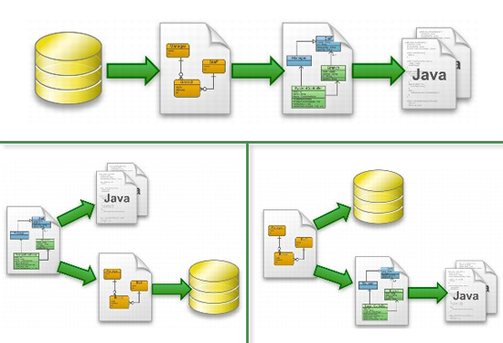
Object-Relational Mapping (ORM)
Hibernate
Java Persistence API
Torque
ORMLite
Notes:
High level libraries for work with DB

Slide 40
ACID
Atomicity - requires that each transaction be "all or nothing".
Consistency - The consistency property ensures that any transaction will bring the database from one valid state to another.
Isolation - ensures that the concurrent execution of transactions results in a system state that would be obtained if transactions were executed serially, i.e., one after the other.
Durability - ensures that once a transaction has been committed, it will remain so, even in the event of power loss.

Slide 41
Literature
Java Database Connectivity
Java JDBC
JDBC tutorials (without Spring)
Relational vs Non-relational databases

Slide 42
Homework Task 1
Implement a servlet with interface: `/app?action=[add/update/remove/invalidate]&name=...&value=...`
The servlet generates a form with input fields "action", "name", "value" and button "Submit". Below print is a list of all attributes of the user storage.
action - depending on the value, the servlet adds, updates, or removes an attribute in/from a storage;
name - the name of the attribute;
value - is the value of the attribute.
Microsoft Edge users data should be stored only in session and removed after cleaning browser cache. Google Chrome users data should be stored in database. User unique identifier should be entered by user before any actions allowed. All browsers except Edge and Chrome are disallowed:
Use H2 database;
Database name - student first and last name;
Database should be automatically created on program startup if does not exist, if exists – skip creation;
Tables should be automatically populated on program startup;
After every server start database should be empty;
Declare host, login, password and database name in application.conf file located in resources folder.
Add request logging filter. Log endpoints path and total execution time. Should measure all actions (even when request blocked);
Cover logic by unit tests;
If any error happens – log error into log file, and redirect user to custom error page with high level info (without SQL specific terminology).

Slide 43
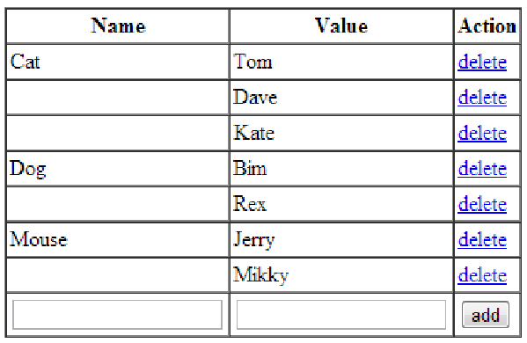
Homework Task 1

